Slide 1

Software Engineer at Cox Automotive in Atlanta, GA
Instructor at the Georgia Tech Coding Boot Camp powered by Trilogy Education
Senior Tutor for Trilogy Education’s global programs
Esterling Accime

Slide 2





Lambda
API Gateway
S3
Cognito
Dynamodb

Slide 3
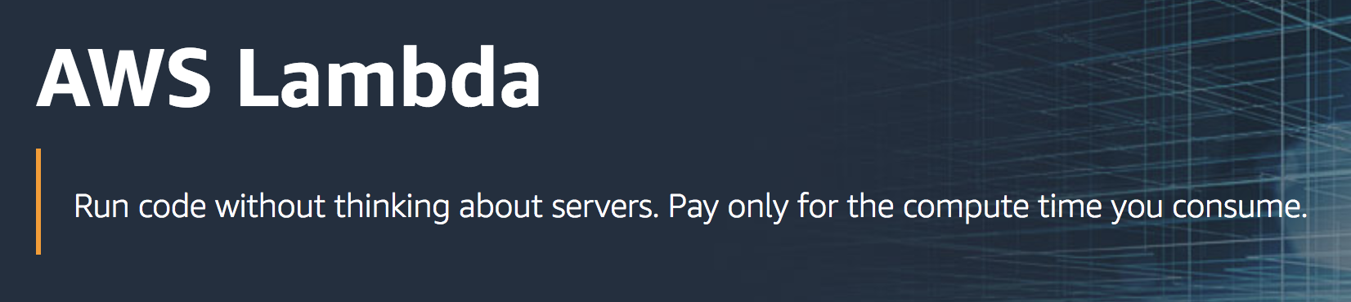
Let you run code without provisioning or managing servers
No charge when your code is not running
Zero administration

Slide 4
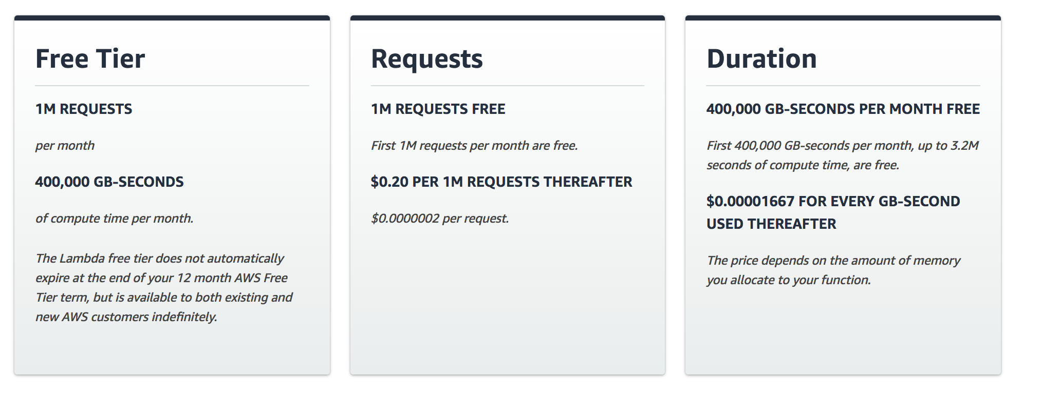
Lambda Pricing:

Slide 5
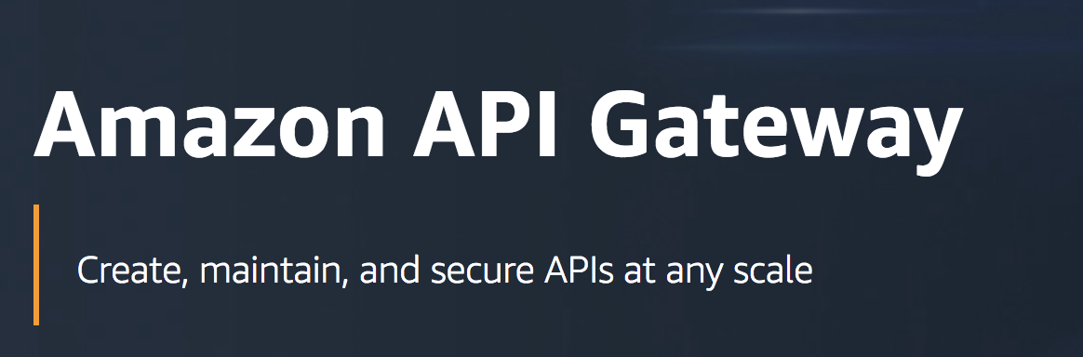
Easy for developers to create, publish, maintain, monitor, and secure APIs at any scale
Create REST and WebSocket APIs

Slide 6
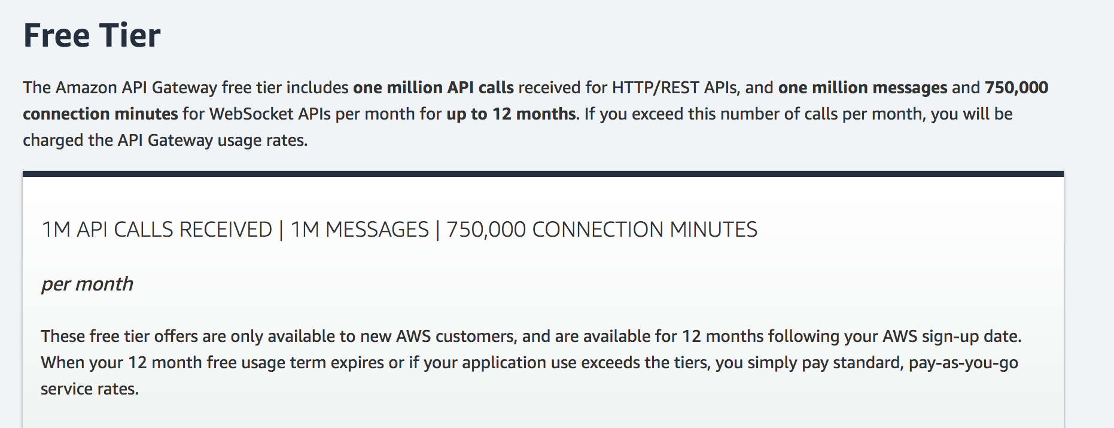
API Gateway Pricing

Slide 7
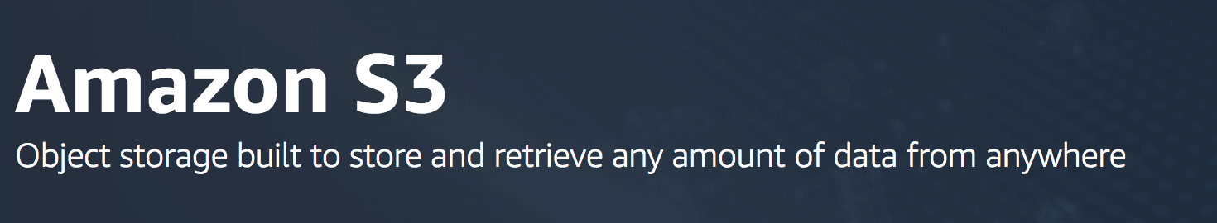
Object storage service
Store and protect any amount of data

Slide 8
S3 Pricing
As part of the AWS Free Usage Tier, you can get started with Amazon S3 for free. Upon sign-up, new AWS customers receive 5GB of Amazon S3 storage in the S3 Standard storage class, 20,000 GET Requests, 2,000 PUT Requests, and 15GB of Data Transfer Out each month for one year.

Slide 9
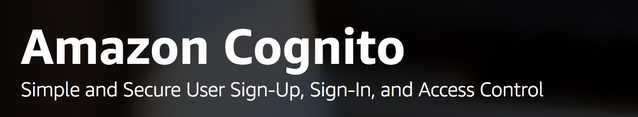
Let you add user sign-up, sign-in, and access control to your web and mobile apps quickly and easily.
Scales to millions of users and supports sign-in with social identity providers:
Facebook,
Google,
Amazon
Enterprise identity providers via SAML 2.0.

Slide 10
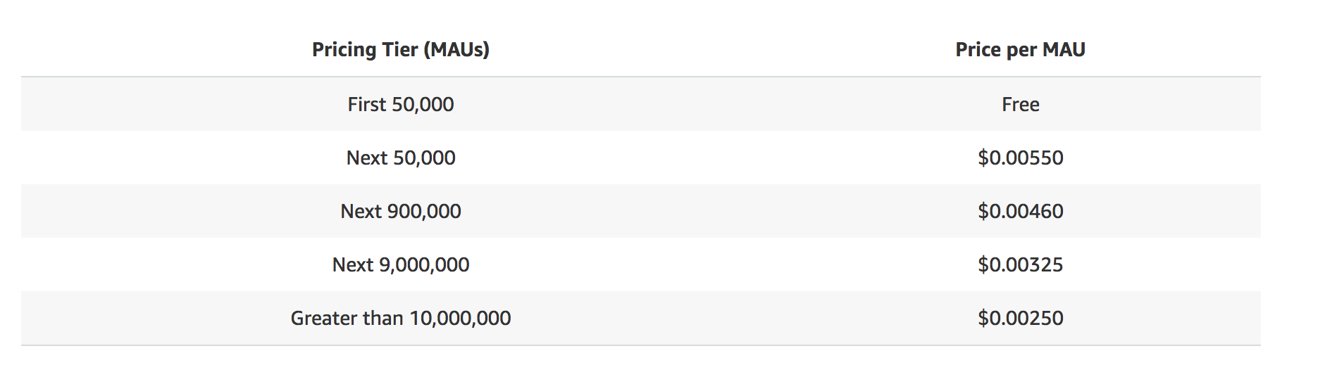
Cognito Pricing:

Slide 11
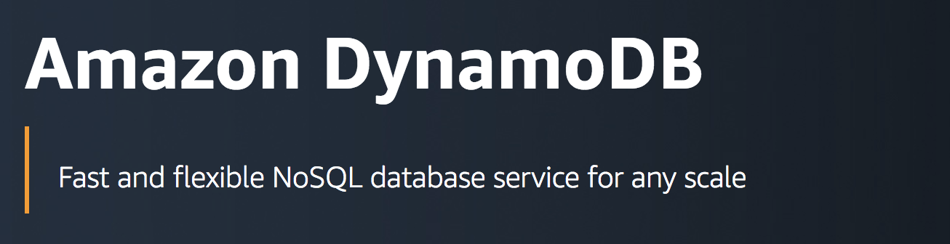
Amazon DynamoDB is a key-value and document database
Deliver single-digit millisecond performance at any scale
Handle more than 10 trillion requests per day
Support peaks of more than 20 million requests per second.

Slide 12

Application Architecture
1
HTML, CSS, JavaScript
S3
2
Authentication
Cognito
3
4
Dynamic API calls over http
API Gateway
Lambda
Dynamodb

Slide 13
3 ways to get started
With AWS
Console
CloudFormation
CLI

Slide 14
Live Demo

Slide 15

EsterlingAccime

